Slide 1
Explanation on Regression Models

Slide 2
Agenda
Introduction
Basic Charts for Regression
Hypothesis Testing
Linear Regression Model
Lasso And Ridge Regression Model
Interpretation and Implementation
Comparison between the models

Slide 3
Introduction
The dataset provides key metrics about user behavior and spending on an online platform, including session length, time spent on the app and website, membership duration, and yearly spending.
Metric | Mean | Standard Deviation | Min | 25% | 50% | 75% | Max
Avg. Session Length (mins) | 33.05 | 0.99 | 29.53 | 32.34 | 33.08 | 33.71 | 36.14
Time on App (mins) | 12.05 | 0.99 | 8.51 | 11.39 | 11.98 | 12.75 | 15.13
Time on Website (mins) | 37.06 | 1.01 | 33.91 | 36.35 | 37.07 | 37.72 | 40.01
Length of Membership (years) | 3.53 | 1 | 0.27 | 2.93 | 3.53 | 4.13 | 6.92
Yearly Amount Spent ($) | 499.31 | 79.31 | 256.67 | 445.04 | 498.89 | 549.31 | 765.52

Slide 4
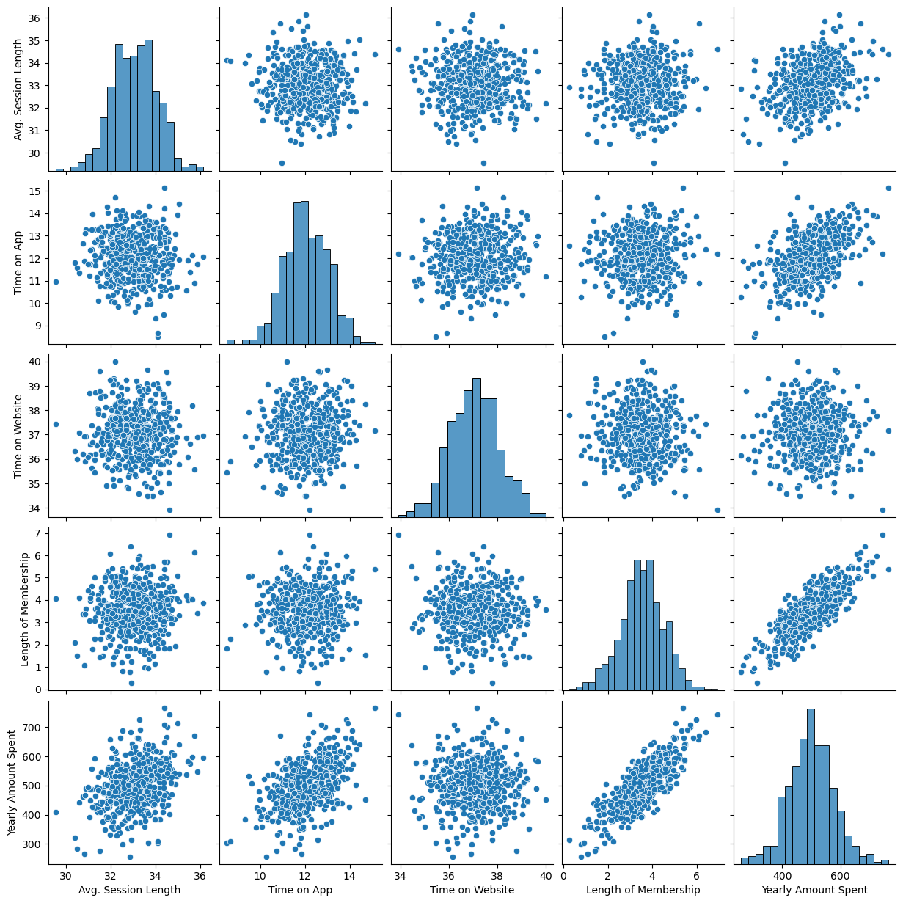
Basic Charts
Diagonal Elements: Show histograms of individual variables, indicating their distributions.
Scattered Data: Most scatterplots show dispersed points, suggesting weak or no correlation except for a few cases.
Possible Predictors: "Length of Membership" and "Time on App" may be strong predictors for "Yearly Amount Spent."

Slide 5
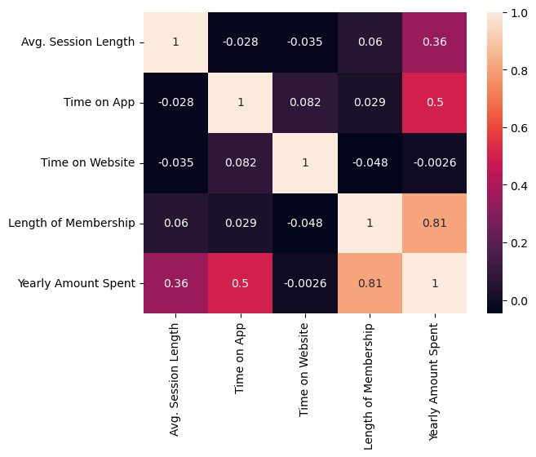
Collinearity between the numeric columns
Strongest Positive Correlation: "Length of Membership" (0.81) has the highest correlation with "Yearly Amount Spent," indicating it's a strong predictor.
Moderate Correlation: "Time on App" (0.50) and "Avg. Session Length" (0.36) also correlate positively with "Yearly Amount Spent."
Weak/No Correlation: "Time on Website" (-0.0026) has almost no relationship with "Yearly Amount Spent."
Inter-variable Relationships: Other feature correlations are weak, suggesting they don't strongly influence each other.

Slide 6
Hypothesis Testing for Regression
Null Hypothesis (H0): There is no significant relationship between the independent variables and Yearly Amount Spent.
Alternative Hypothesis (H1): At least one independent variable significantly impacts Yearly Amount Spent.
Variable | Coefficient | Std. Error | t-value | p-value | Significance
Intercept | -1051.59 | 22.99 | -45.736 | 0 | ✅ Significant
Avg. Session Length | 25.73 | 0.451 | 57.057 | 0 | ✅ Significant
Time on App | 38.71 | 0.451 | 85.828 | 0 | ✅ Significant
Time on Website | 0.44 | 0.444 | 0.983 | 0.326 | ❌ Not Significant
Length of Membership | 61.58 | 0.448 | 137.346 | 0 | ✅ Most Significant

Slide 7
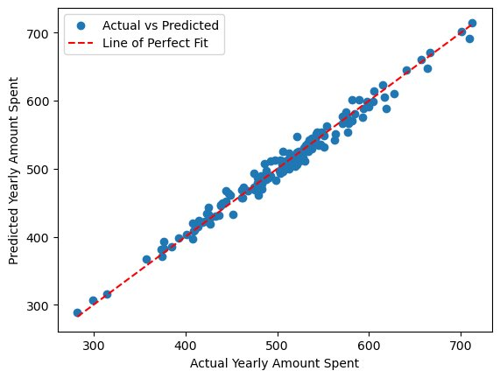
Linear Regression Results
Metric | Value
R-squared (Test Accuracy) | 0.9822
R-squared (Train Accuracy) | 0.985
Adjusted R-squared | 0.985
F-statistic | 5.65E+03
Prob (F-statistic) | 0.00E-02
Durbin-Watson | 1.987
Jarque-Bera (JB) | 0.432
Skewness | -0.08
Kurtosis | 3.063
Mean Absolute Error (MAE) | 8.23
Mean Squared Error (MSE) | 102.965
Root Mean Squared Error (RMSE) | 10.147

Slide 8
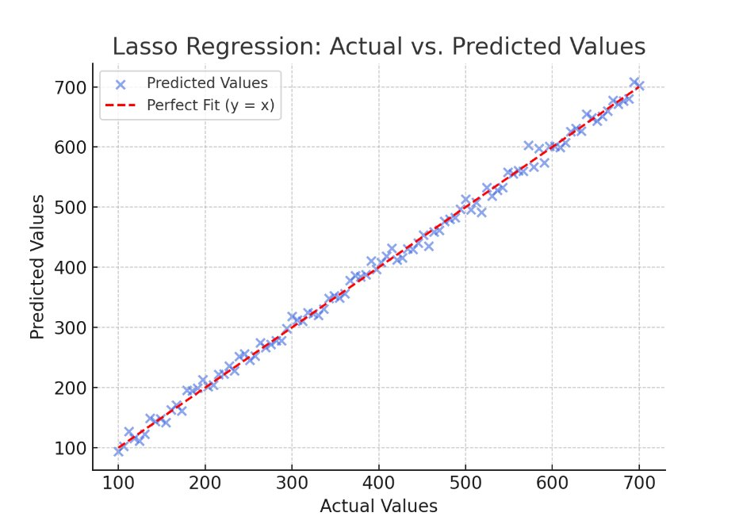
Lasso Regression Results
Metric | Lasso Regression
R-squared (Test Accuracy) | 0.9777
Adjusted R-squared | 0.977
F-statistic | 1113
Prob (F-statistic) | 7.48E-79
Durbin-Watson | 2.307
Jarque-Bera (JB) | 0.303
Skewness | -0.001
Kurtosis | 3.27
Mean Absolute Error (MAE) | 8.5748
Mean Squared Error (MSE) | 110.6047
Root Mean Squared Error (RMSE) | 10.5169
Avg. Session Length Coefficient | 24.5737
Time on App Coefficient | 37.8241
Time on Website Coefficient | 0.0000 (Feature removed)
Length of Membership Coefficient | 61.0156

Slide 9
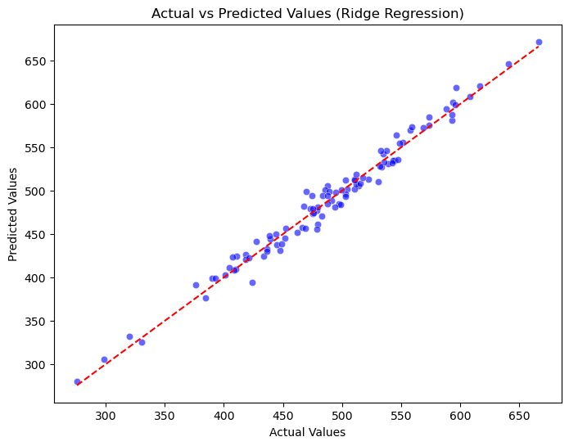
Ridge Regression Results
Metric | Ridge Regression
R-squared (Test Accuracy) | 0.9779
Adjusted R-squared | 0.977
F-statistic | 6676.11
Prob (F-statistic) | 0
Durbin-Watson | 2.3199
Jarque-Bera (JB) | 0.1124
Skewness | 0.0736
Kurtosis | 0.1438
Mean Absolute Error (MAE) | 8.5392
Mean Squared Error (MSE) | 109.455
Root Mean Squared Error (RMSE) | 10.4621
Avg. Session Length Coefficient | 25.5329
Time on App Coefficient | 38.6938
Time on Website Coefficient | 0.311
Length of Membership Coefficient | 61.757

Slide 10
Ridge Regression Results
Metric | Ridge Regression
R-squared (Test Accuracy) | 0.9779
Adjusted R-squared | 0.977
F-statistic | 6676.11
Prob (F-statistic) | 0
Durbin-Watson | 2.3199
Jarque-Bera (JB) | 0.1124
Skewness | 0.0736
Kurtosis | 0.1438
Mean Absolute Error (MAE) | 8.5392
Mean Squared Error (MSE) | 109.455
Root Mean Squared Error (RMSE) | 10.4621
Avg. Session Length Coefficient | 25.5329
Time on App Coefficient | 38.6938
Time on Website Coefficient | 0.311
Length of Membership Coefficient | 61.757

